Slide 1
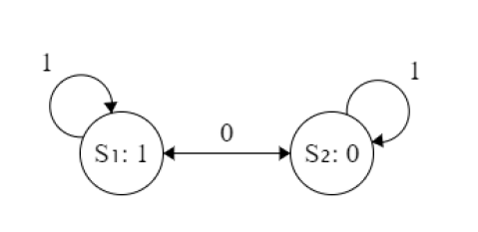
This must be vector art. Draw with powerpoint circles
Notes:
Figure: State machine for changing between main and transfer regions. The input is the location status of the object. Based on the current region, the location status can either be a 1 or 0. S1 is the main regions. S2 is the transfer regions.

Slide 2
Main Region 2
Main Region 1
Main Region 0
Goal Without Regions
Goal With Regions
Object
Robots in Region
Robots out of Region
GOAL
Notes:
Figure: The blue rectangles represent the main regions. The main regions are bounded by the blue dashed lines, which are extensions from the pink obstacles to another obstacle or a size of the maze.

Slide 4
Transfer Region 1
Transfer Region 2
Notes:
Figure: The blue rectangles represent the transfer regions. The boundary of the transfer regions is indicated by a green dashed line, which is a tangent line drawn from the end of the pink obstacle.

Slide 5
